Slide 1
Software Design Pattern
Topic : Builder Design Pattern
240160510008 – Desai Manish
240160510037 – Prajapati Praveen

Slide 2
Intent:
The Builder Design Pattern is a creational design pattern that is used to construct complex object step by step.

Slide 3
Motivation: Why use the Builder design pattern
1. Simplifies Object Creation: The Builder pattern helps create complex objects (like a software with multiple parts) by breaking it into smaller, easy-to-manage steps, making the process clearer and simpler.
2. Avoids Complex Constructors: Instead of dealing with one large constructor with many parameters, the Builder pattern lets you set each part of an object separately, keeping the code cleaner and more manageable.
3. Improves Code Readability: By building an object step-by-step, the Builder pattern makes the code more understandable because you can see clearly what each part of the object is without being overwhelmed by too many parameters.

Slide 4
Structure diagram :
SDLCBuilder
SDLCConcreteBuilder
SoftwareProject

Slide 5
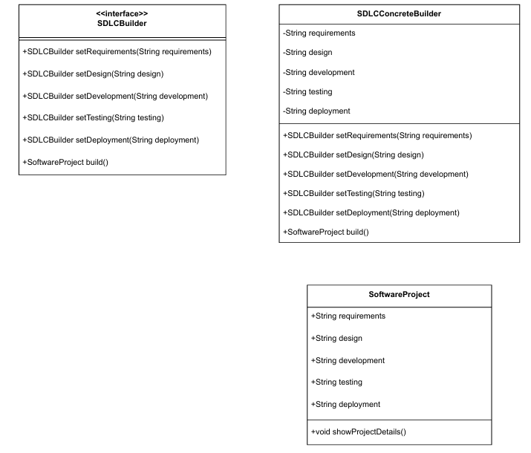
Class diagram :

Slide 6
Role Of Particioent:
1. Builder Interface (SDLCBuilder)
Role: Defines the blueprint for building a complex object. Responsibility: Declares methods to set different phases of software
development.
Ensures a step-by-step approach to object creation.
2. Concrete Builder (SDLCConcreteBuilder )
Role: Implements the builder interface to construct and assemble a
SoftwareProject. Responsibility: Maintains an instance of SoftwareProject.
Implements methods to set each phase of the project.
Returns the final SoftwareProject object.
3. Product (SoftwareProject)
Role: The final complex object that is built. Responsibility : Stores all information related to the software project.

Slide 7
Consequences:
Benefits:
1. Encapsulates Object Construction Logic
The builder class handles the complexity of object creation.
The client only cares about setting values without worrying about how the
object is built.
2. Allows Object Customization (Simple Explanation)
The Builder Pattern lets you create objects step by step, so you can choose
which parts to include and which to skip.
3. Step-by-Step Object Creation
The Builder Design Pattern is a creational design pattern that is used to
construct complex objects step by step.

Slide 8
Drawbacks :
1. More Code Complexity
The Builder Pattern requires extra classes (Builder, ConcreteBuilder,
Product).
For simple objects, using a constructor or setters is easier.
2. Slower Performance
Unlike a constructor, the builder creates objects in multiple steps, which
takes more time.

